Slide 1

Smart Attendance System
-KAVISH SHAH(IU1741230050)
-HARSH SHAH(IU1741220050)
PROJECT GUIDE (IDP):
COMPANY:-MAXGEN TECHNOLOGIES
INTERNAL GUIDE:-DR.NIMISHA PATEL

Slide 2

CONTENT:
PROJECT INTRODUCTION
PROJECT DEFINITION
ABSTRACT
LITERATURE SURVEY OF YOUR PROJECT
PROJECT SCOPE
TECHNOLOGIES USED IN THE PROJECT
HAAR CASCADE CLASSIFIER
LOCAL BINARY PATTERN HISTOGRAM
PROJECT RELATED DIAGRAMS
EXECUTION OF PROJECT
PROJECT ACCURACY

Slide 3

PROJECT INTRODUCTION:
Many MNC companies and institutes are still using the old paper or file based systems but some have adopted strategies of automatic attendance using some biometric techniques.
Smart attendance system is a computerized biometric software which is suited for determining and validating a person by performing comparison on patterns based on their facial appearances.
This technology is now vastly used for various objectives like security and in commercial operations.
Face recognition for the intent of marking attendance is a resourceful application of attendance system.

Slide 4

PROJECT DEFINITION:
Smart Attendance System based on Face Recognition using Haar Cascade Classifier and Local Binary Pattern Histogram (LBPH).

Slide 5

ABSTRACT:
Face is the crucial part of the human body that uniquely identifies a person. Using the face characteristics as biometric, the face recognition system can be implemented. Attendance of employees in a large company is hard to be handled by the traditional system, as it is time-consuming and has a high probability of error during the process of inputting data into the computer. Our model integrates a camera that captures an input image, an algorithm for detecting face from an input image, encoding and identifying the person registered already by the company. Our proposed system uses Haar cascade classifier to detect and locate the face and LBPH (Local binary pattern histogram) algorithm for face recognition by using Python programming and OpenCV library. Here we use tkinter for admit interface purpose.

Slide 6
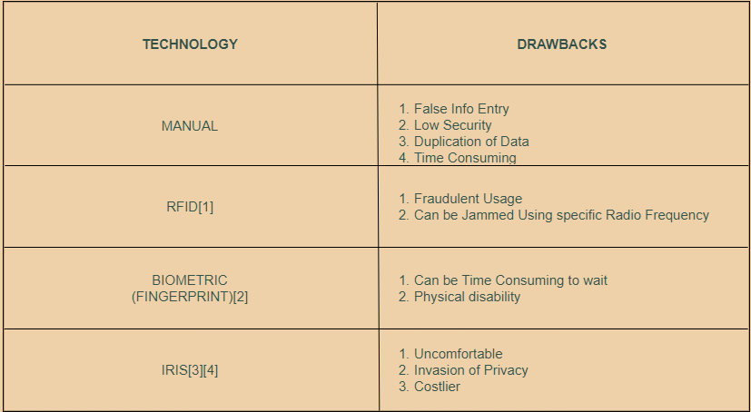
LITERATURE SURVEY OF THE PROJECT:

Slide 7
PROJECT SCOPE:
Our project simplifies time tracking, and there is no need to have personnel to monitor the system 24 hours a day.
A time and attendance system using facial recognition technology will accurately report attendance with an identification process that is fast as well as accurate.
It will accurately track time and attendance without any human error.
Our system has high security that won't allow anyone to invade the privacy or fraudulent usage as well as it is not time consuming.

Slide 8
TECHNOLOGIES USED IN THE PROJECT:
Technology: Python, Machine Learning Algorithm
Front End: Tkinter (GUI)
Back End: Haarcascade Classifier, LBPH
Editor: Python IDLE, Spyder, Jupyter Notebook.
Libraries: Pandas, NumPy, OpenCV

Slide 9
FACE DETECTION:

Slide 10
HAAR CASCADE CLASSIFIER:
Face Detection using Haar feature-based cascade classifiers is an effective method proposed by Paul Viola and Michael Jones.
It comes under machine learning based approach where a cascade function is trained from lots of positive (images of faces) and negative (images without faces) images.
For Face Detection, it will extract features from the face.

Slide 11
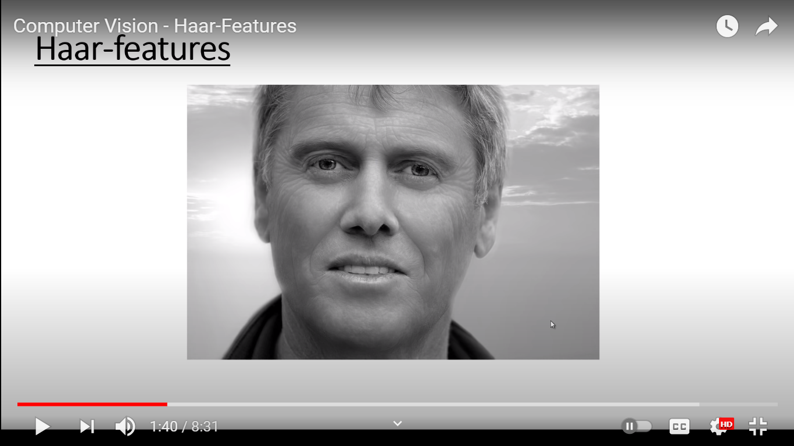


EXAMPLE:
GRAYSCALE IMAGE
EXTRACTING HAAR-FEATURES

Slide 12
FACE RECOGNITION:

Slide 13
LOCAL BINARY PATTERN HISTOGRAM:
Local Binary Patterns Histogram algorithm was proposed in 2006.
Local Binary Pattern (LBP) is a simple yet very efficient operator which labels the pixels of an frame and consider the results as a histogram.
Then it compares this histogram with the existing ones.
Finally, it finds the best match and returns the label person associated with this best match.

Slide 14
WHY WE CHOSE HAAR CASCADE CLASSIFIER AND LBPH?
Haar Cascade Classifier is better even in low light and gives better accuracy.
LBPH algorithm because of its robustness, the capability to recognize both front and side faces and better compared to Eigenfaces and Fisherfaces.
It can represent local features in the images.
It is possible to get great results (mainly in a controlled environment)

Slide 15
PROJECT RELATED DIAGRAMS:

Slide 16
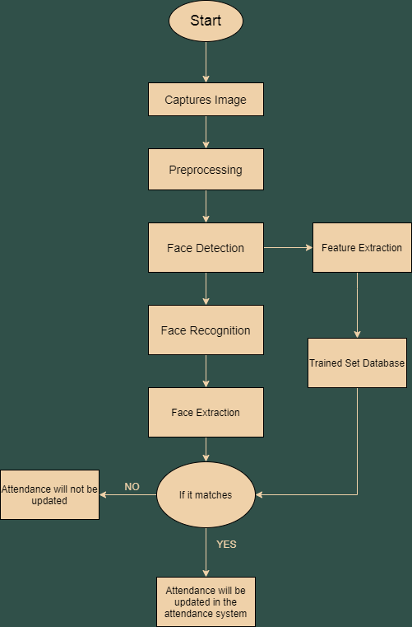
SYSTEM FLOW
CHART:

Slide 17
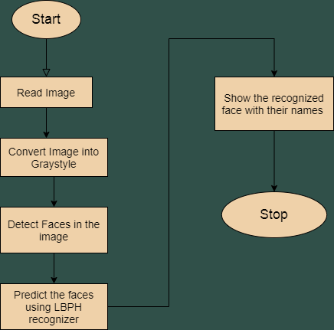
FACE DETECTION AND RECOGNITION FLOW-CHART:

Slide 18
EXECUTION OF PROJECT:

Slide 19
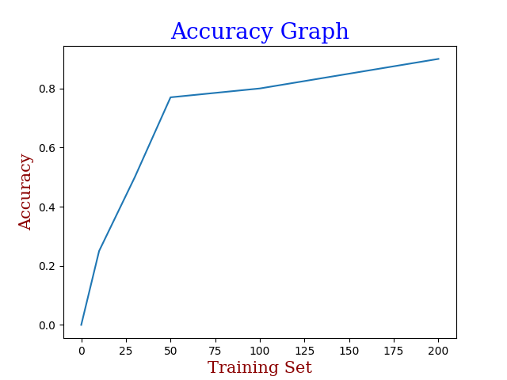
ACCURACY:
As shown in the graph, we have taken different number of images as a training set.
We considered 3 feet as the distance of a face for recognition.
As a result, at 50 images as a training set we got 77% of accuracy and it increases as the training images increases.
It reaches upto 96% at 200 training images, but it also consumes more space and needs high processor to train the images.

Slide 20
REFRENCES:
[1] Ononiwu G. Chiagozie, Okorafor G. Nwaji, “Radio-frequency
identification (RFID)based Attendance System with Automatic Door
Unit”, Academic Research International(2012).
[2] O. Shoewu, PhD, O.A. Idowu, B.Sc., “Development of Attendance
Management System using Biometrics.”, The Pacific Journal of Science
and Technology(2012).
[3] A. Khatun, A. K. M. F. Haque, S. Ahmed and M. M. Rahman, ”Design and
implementation of iris recognition based attendance management system”,
2015 International Conference on Electrical Engineering and Information
Communication Technology (ICEEICT), Dhaka, 2015, pp.1-6.
[4] Kadry, Seifedine Smaili, Mohamad. (2010). ”Wireless attendance
management system based on iris recognition”. Scientific Research and
Essays. 5. 1428-1435.

Slide 21
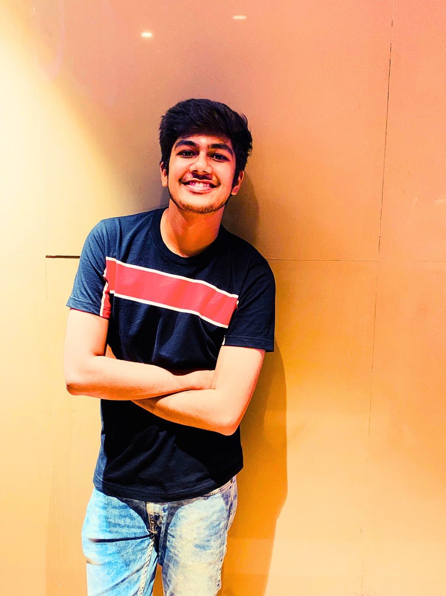

THANK YOU
HARSH SHAH
IU1741220050
IT
KAVISH SHAH
IU1741230050
CS

